Slide 1


A Project On “Employee Management System”
Submitted by:-
1.Md.Mahmudul Hasan (171-15-1315)
2.Md.Fakrul Islam (171-15-1316)
3.Ahmed Nur A Jalal (171-15-1324)

Slide 2
TABLE OF CONTENTS 1. PROJECT DESCRIPTION 2. SNAPSHOT 3. CONCLUSION 4. FUTURE SCOPE 5. REFERENCES

Slide 3
PROJECT DESCRIPTION
Objective of C project on Employee Management System :-
The main objective of this C project on Employee Management is to manage the details of information of an employee.
It manages all the information about name, id and salary.
The project is totally built at administrative end thus only administrator is guaranteed the access.
The purpose of the project is to build an application program to reduce the manual work for managing the information's.

Slide 4
Functionalities provided by C project on Employee Management system are as follows:
1)Provides the searching facilities based on id
2)It tracks all the information
3)Manage the information
4)It increase efficiency of managing the information
6)Editing, adding and updating of Records is improved which results in proper resource management of information of data.

Slide 5
Input Data and Validation
1) All the fields such as salary, id and names are validated and
don’t take invalid arguments.
2) Each form like Employee, Salary don’t take blank values.
3) Avoiding errors in data.
4) Controlling amount of input.

Slide 6
Objectives of the Project:-
Time and Cost Effective – Software is making the process of keeping database
time and cost effective by making it easy to alter or update database and also keeping that safe.
Database Creation - A database of the registered users will be created and this will help the users to fetch the data
Flexibility – Database provides flexibility to administrator. Records can be
inserted, deleted or updated
Informative - The software has all the necessary details about the Employee and provides all the relevant information.

Slide 7
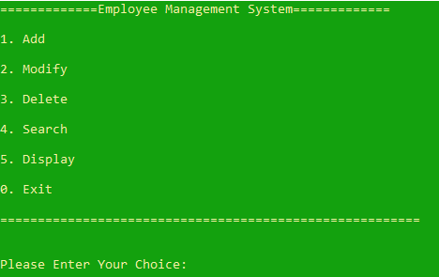
SNAPSHOTS
Figure-1: Main Menu

Slide 8
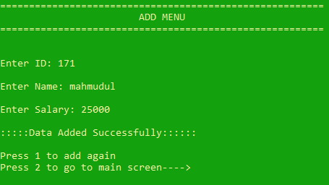
Figure-2: ADD Menu

Slide 9
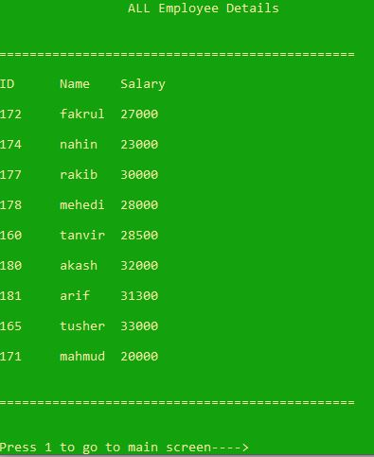
Figure-3: All Employee Details Menu

Slide 10
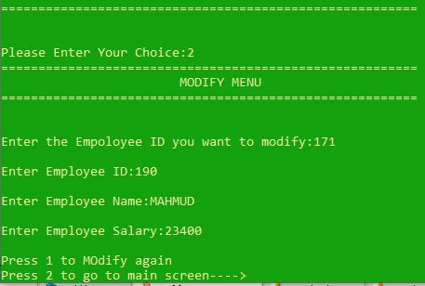
Figure-4: Modify Menu

Slide 11
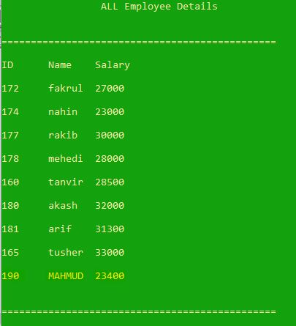
Before Modification
After Modification

Slide 12
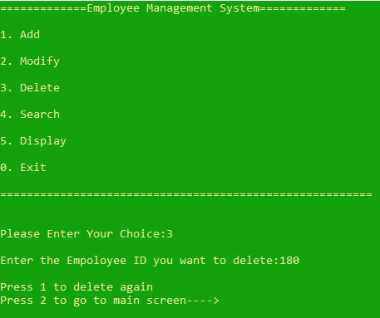
Figure-5: Delete Menu

Slide 13
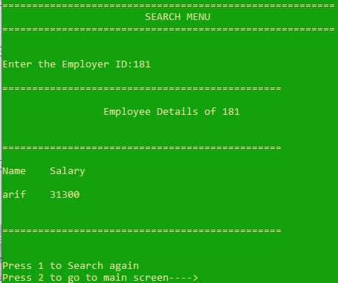
Figure-6: Search Menu

Slide 14
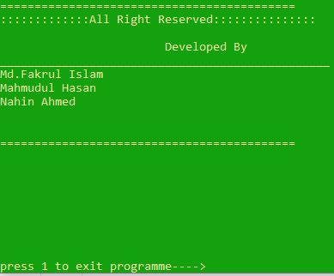

Slide 15
CONCLUSION
The project is to digitalize the database of Employees in Organizations and enabling administrators to have benefit from Computers.
This Software acts as a Information System between Employees and administrators. Here the user can keep his/her database secure and safe for a unlimited period of time.
This Software provides Employee management System for inserting ,updating, Searching and deleting records with ease and simplicity. We will provide a fresh new approach to users to search for records and make databases in a digital way.

Slide 16
The End

